Slide 1
Yelp Data Analysis
By: Jason Amaro, Federico Wang

Slide 2
Objective
The objective of this project is to determine the most popular service on Yelp, as well as, the top 10 rated services form the Yelp Dataset
The metric used to find the most popular service will be the number of reviews posted by user of said service.
The metric used to find the top 10 rated services will be the average of the ratings i.e (sum of rating/ total # reviews)

Slide 3
Data
Yelp Dataset, more specifically the Yelp customer review, and business subsets.
Yelp customer review dataset is about 3.79 GB (before preprocessing)
Yelp business review dataset is about 31.76 MB (Before Preprocessing)
Source:https://www.kaggle.com/yelp-dataset/yelp-dataset/version/4
Chosen because csv file were provided

Slide 4
Analysis of Data
Preprocess the customer review csv file to have columns business_Id (for Most Pop. Service), and business_Id, stars (for Top Ten Services)
For solving the most popular service we will treat it like a word count problem. (With the addition of an extra MapReduce job)
For finding the most top 10 rated service the mapper will do the same as above but the reducer will output the average of the ratings. (With the addition of an extra MapReduce job

Slide 5
Most Popular Service - Mapper1A.py & Reducer1A.py
Mapper1A.py Input: reads in yelp_review1.csv (contains buisness_Id only)
Mapper1A.py Output: intermediate key-value pairs in the form (business_Id, 1)
Reducer1A.py Input: intermediate key_value pairs generated by Mapper1A.py
Reducer1A.py Output: key-value pairs in the form of (business_Id, freq) in a csv file P1PA.csv

Slide 6
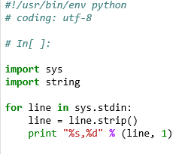
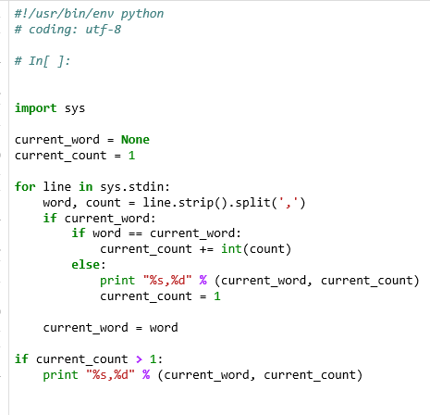
Most Popular Service - Mapper1A.py & Reducer1A.py

Slide 7
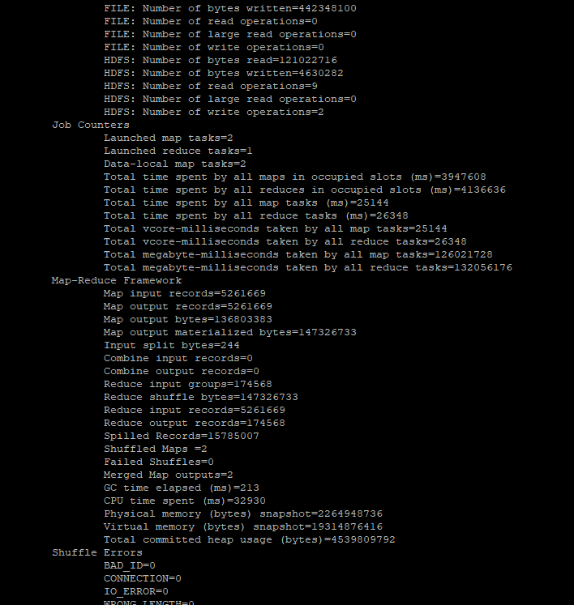

Slide 8
Most Popular Service - Mapper1B.py & Reducer1B.py
Mapper1B.py Input: reads in P1PA.csv (contains buisness_Id and freq only)
Mapper1B.py Output: one key-value pair in each split with the highest frequency in the form (business_Id, freq)
Reducer1B.py Input: intermediate key-value pairs generated by Mapper1B.py
Reducer1B.py Output: a key-value pair with the highest frequency in the form of (business_Id, freq) in a csv file P1PB.txt

Slide 9
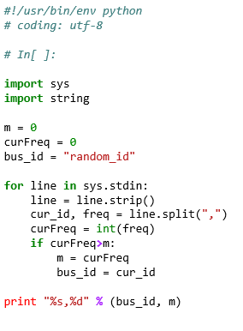
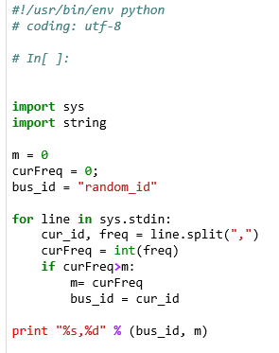
Most Popular Service - Mapper1B.py & Reducer1B.py

Slide 10
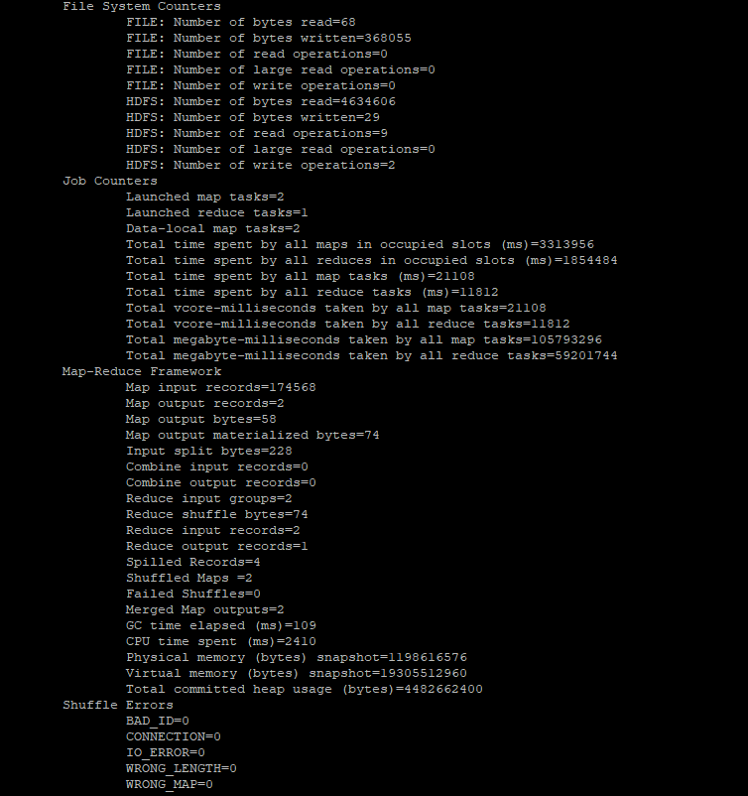

Slide 11
10 Highest Rated Services - Mapper2A.py & Reducer2A.py
Mapper2A.py Input: reads in yelp_review2.csv (contains buisness_Id, stars)
Mapper2A.py Output: intermediate key-value pairs in the form (business_Id,stars, 1)
Reducer2A.py Input: intermediate key_value pairs generated by Mapper2A.py
Reducer2A.py Output: key-value pairs in the form of (business_Id, average_rating) in a csv file P2PA.csv

Slide 12
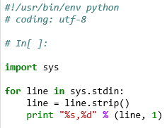
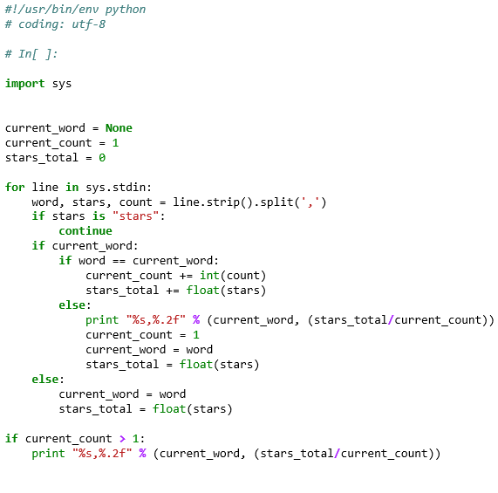
10 Highest Rated Services - Mapper2A.py & Reducer2A.py

Slide 13
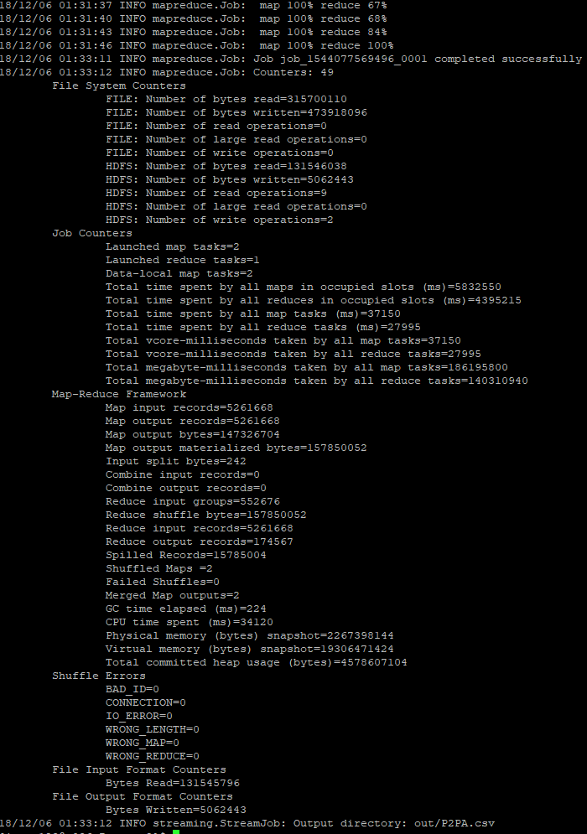

Slide 14
10 Highest Rated Services - Mapper2A.py & Reducer2A.py
Mapper2B.py Input: reads in P2PA.csv (contains buisness_Id, average star rating)
Mapper2B.py Output: 10 key-value pairs in each split with the highest average star ratings in the form (average_rating, business_Id)
Reducer2B.py Input: intermediate key-value pairs generated by Mapper2B.py
Reducer2B.py Output: 10 key-value pairs in each with the highest average star ratings in the form (average_rating, business_Id) P2PB.txt

Slide 15
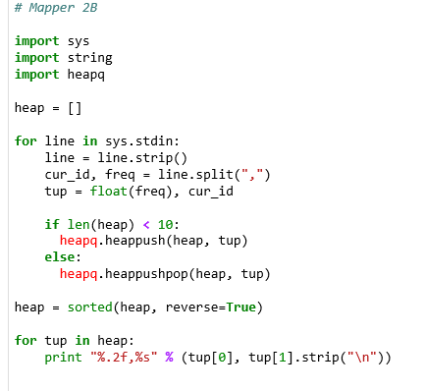
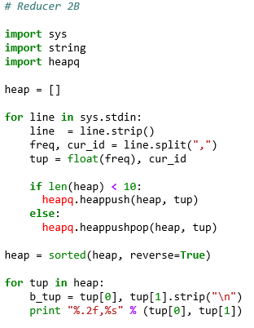
10 Highest Rated Services - Mapper2B.py & Reducer2B.py

Slide 16
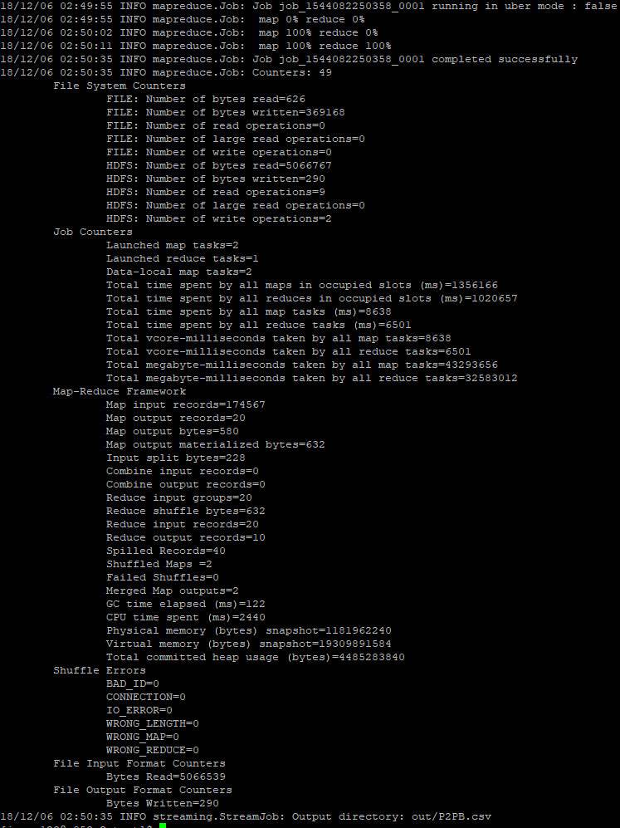

Slide 17
Conclusion - Most Reviewed Service
The output of Reducer1B.py is 4JNXUYY8wbaaDmk3BPzlWw,7362
Using the business_review.csv we found the most highly review business/service was Mon Ami Gabi

Slide 18
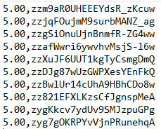
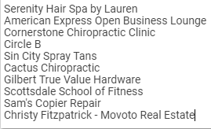
Conclusion - Top Ten Rated Services
The output of the Reducer2B.py is

